Slide 1
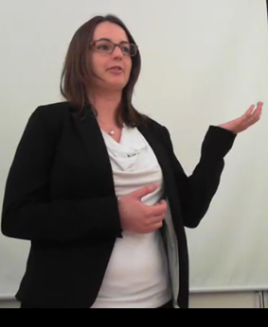
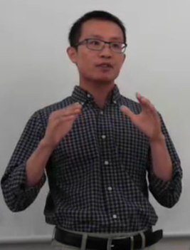
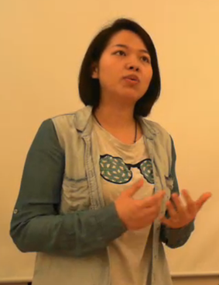
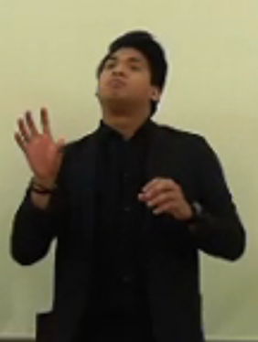
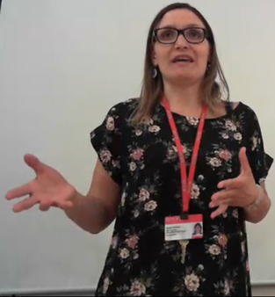
Transforming Scientists into Storytellers
Janet Alder, Holly Hilton, Mary Nucci, David Dannenfelser, Nick Linardopoulos and Nicholas M. Ponzio
School of Graduate Studies, School of Environmental and Biological Sciences, Mason Gross School of the Arts, School of Communications and Information, Rutgers University
Background
Science PhD students are trained to conduct experiments but little attention is given to teaching them to communicate their research. Since scientists are held in high regard and have the potential to influence a range of audiences including peers, students, clinicians, policy makers, donors and the media, the ability to connect with these diverse groups and distill their message in a clear and concise manner is critical.
Syllabus: short didactic followed by in class activity
Pictures of students talking here
Outcomes
Speech giving (Partner Exercise)
Text analysis (The What) – paraphrase partner’s speech
Beat and Objectives (The Actions) – to do what, with, who, for
Emotional Essence (The So What) – analogies and metaphors
Delivering the Speech (The How) – tell story and focus on partner
Students completed an anonymous electronic evaluation survey (n = 13) .
Aim
To create a course for graduate students that teaches them how to communicate their research to various audiences with the ultimate goal of promoting career development.
Methods
Faculty: interdisciplinary team including theater, communications, marketing, and research
Students: 20 PhD students from diverse disciplines ranging from biological and chemical sciences to civil engineering.
Activities: improvisational theater exercises, public speaking techniques, elevator pitches, abstract and manuscript writing, effective slide and poster. presentations, cutting-edge teaching approaches, interaction with the media, persuasive communication, and interview skills.
Assessment: before and after video recordings of 3 min theses as well as other assignments.
Capstone project: each student was also mentored by a professional on a capstone project related to their career of interest.
Funding: pilot class was supported by a Burroughs Wellcome Fund Grant.
Sample Capstone Projects: the students worked with
Rutgers Office of Research Commercialization to prepare a presentation to a venture capital group for funding
Faculty members of local colleges to participate in teaching undergraduate science courses
Professionals at the U.S. Food and Drug Administration to learn more about the regulatory affairs approval process
Rutgers Eagleton Institute of Politics to prepare a presentation for local politicians to sponsor a bill
Professionals in science communications to prepare a presentation on a drug’s mechanism in disease for physicians and other key opinion leaders
Researchers at Rutgers University, pharmaceutical companies and consulting firms to prepare discipline-specific resumes and cover letters in response to advertisements for postdoctoral or entry-level job opportunities.
Sample improv exercises
Distill your message and know your audience: describe cell phone and xray to someone from 1600’s
Storytelling: blank paper picture exercise
Respond to your audience: hot and cold clapping game to get someone to do something
Modify your speech as needed: one word story add on
Areas for Follow-up
Future iterations of the course will include more structure for the capstone projects so that mentors can be utilized to their full potential.
Moreover, lecture content will be made more brief to allow additional time for in class practice and group feedback.

